Slide 1
Memory Hierarchy
Cache Overview

Slide 2
Increase in Memory Accesses
The processor line shows the increase in memory requests per second on average through these years, while the memory line shows the increase in DRAM accesses per second

Slide 3
Cache Optimization
A modern high-end processor such as the Intel Core i7 can generate two data memory references per core each clock cycle; with four cores and a 3.2 GHz clock rate, the i7 can generate a peak of 25.6 billion 64-bit data memory references per second, in addition to a peak instruction demand of about 12.8 billion 128-bit instruction references;
In contrast, the peak bandwidth to DRAM main memory is only 8% of this.
This is achieved by cache optimizations e.g multiporting, pipelining etc

Slide 4
Memory Hierarchy Overview Principle of Locality
Library analogy
A program accesses a very small portion of their address space at an instance of time.
Temporal locality:
If an item is referenced, it will tend to be referenced again soon
Spatial locality:
If an item is referenced, items who’s addresses are close by will tend to be referenced soon

Slide 5
Memory Hierarchy Overview

Slide 6
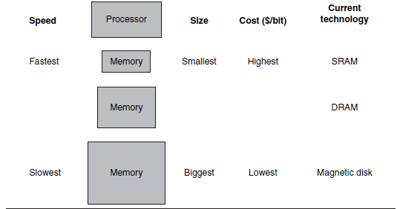
Memory Hierarchy Overview

Slide 7
Memory Hierarchy Overview Cache Terminology
Block or line:
Minimum amount of data present or missing in the cache. May vary from byte to multiple words
Hit Rate:
The fraction of Memory accesses found in a level
Miss Rate:
Fraction not found
Hit Time:
The time required to access a memory level including the time required to determine whether it is a hit or miss
Miss Penalty
Any additional time required because of a miss

Slide 8
Memory Hierarchy Overview AMAT
Traditionally, designers of memory hierarchies focused on optimizing average memory access time, which is determined by the cache access time, miss rate, and miss penalty.
Hit time is a constant offset added whether there is a hit or miss
For Memory hierarchy having L2 cache
AMAT = Hit TimeL1 + Miss RateL1 x (Hit TimeL2 + Miss RateL2 x Miss PenaltyL2)

Slide 9
AMAT Example 1
A CPU has 1ns clock, hit time = 1 cycle, miss penalty = 20 cycles, I-cache miss rate = 5%
Solution:
AMAT = 1 + 0.05 × 20 = 2ns
i.e 2 cycles per instruction (memory instruction)
So if a processor would otherwise running with a CPI of 1. It’s CPI will now increase due to these memory instructions. Exactly CPI depends upon the %age of memory access instructions in the total workload

Slide 10
AMAT Example 2

Slide 11

So the average memory access time is
Miss penalty due to data cache = data cache miss rate* miss penalty
Miss penalty due to instruction cache = instr cache miss rate* miss penalty
CPInew= 1 + Miss penalty due to data cache*mem inst %age in load + Miss penalty due to instruction cache
= 1 + 0.02 (100) + 0.36*0.05*(100) = 1+ 2 + 1.8 = 4.8
So average CPI is 4.8 cycles
If there were no stalls CPI =1. So stall cycles per instruction caused by memory accesss is 3.8.

Slide 12
Memory Hierarchy Overview Cache Mapping
When a processor (Program Counter for instruction cache and lw,sw instruction for data cache) generates an address; how to find it in cache
Direct Mapped
Set-Associative
Fully Associative

Slide 13
Direct Mapped
Main memory
Main Memory is also divided in blocks where block size is equal to cache block
cache Block 0 | Memory Block 0 | Mem 0
 |  | Mem 1
 |  | 2
 |  | 3
cache Block 1 | Memory Block 1 | 4
 |  | 5
 |  | 6
 |  | 7
cache Block 2 | Memory Block 2 | 8
 |  | 9
 |  | 10
 |  | 11
cache Block 3 | Memory Block 3 | 12
 |  | 13
 |  | 14
 |  | 15
cache Block 0 | Memory Block 4 | 16
 |  | 17
 |  | 18
 |  | 19
Block | byte 3 | byte 2 | byte 1 | byte 0
0
1
2
3
Cache with 4 blocks
And block size is 4 bytes
As you can see that
Cache block no. for a memory block =
(Memory Block no.) modulo (Number of blocks in the cache) (1
And
Memory Block No.
= Memory Location address/Block size (in bytes) (2
It is integer division so no floating points

Slide 14
Memory Hierarchy Overview Direct Mapped
In the memory address, identify the bits which specify block no.
If Block Size is 2^{m} bytes and no. of blocks is 2^{n.}, then bit no ‘m’ to bit no ‘m+n-1’ (m+n-1 : m) tell the block no.

Slide 15
Direct Mapped Example Finding a memory address in cache
Suppose there are 2⁶=64 blocks in cache and block size is 4 words= 2⁴ bytes. Where will be the memory location 1234 stored in cache in a 16-bit processor.
Mem block no. =1234/16 = 77th block
Cache block = 77 mod 64 = 13th block
Infact cache block 13 will contain mem location 1232 – 1248 (total 16 bytes)
OR
1234= 0000 0100 1101 0010₂
Here m=4 and n=6, So first 4 bits are bytes with in a block
Next six bits ; no 4 to 4+6-1 i.e 4 to 9 which are
0000 0100 1101 0010
001101₂ = 13

Slide 16
Example continued, Cache Block detail
Block 13 contains actually contains 4 words=16 bytes
0000 0100 1101 0000
To 0000 0100 1101 1111

Slide 17
Example continued Cache storage other than data
Consider Memory addresses 208,1232 and 2256 for a 16-bit system having 64 block cache with block size of 4 words.
208 = 0000 0000 1101 0000
= 0000 0100 1101 0000
2256= 0000 1000 1101 0000
All have the same block no. i.e. 001101 =13.
How can we differentiate?
We need to store the remaining 6 bits as tag along with data for each block
1- bit valid information is also required to describe the status of the data i.e. whether valid or not. It is required in cases such as when system is booted and cache data is not valid

Slide 18
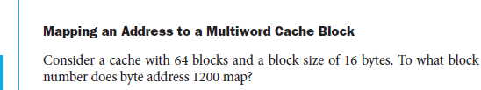
Example

Slide 19
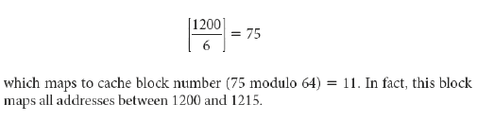
Solution

Slide 20
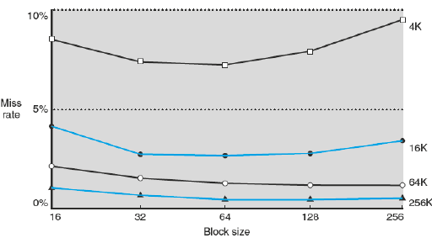
Memory Hierarchy Overview Block size vs miss rate
Increase block size reduces miss rate until block size is comparable to cache size

Slide 21
Memory Hierarchy Overview Set Associative Cache
The location of a memory block in a set associative cache is calculated the same way as we did it for direct mapped
But the location is called a set. i.e replace Block no. with set no.
A set size could be 1,2,4,8,16,...
A set size 1 means a direct mapped cache.
If two blocks map to same set they both can reside because set size is greater than 1, as compared to direct mapped where set size =1

Slide 23
Memory Hierarchy Overview Fully Associative
When a cache has just 1 set and all blocks are in this set, we call it fully associative.
Block can be placed at any vacant place
Block replacement technique can be LRU.

Slide 24
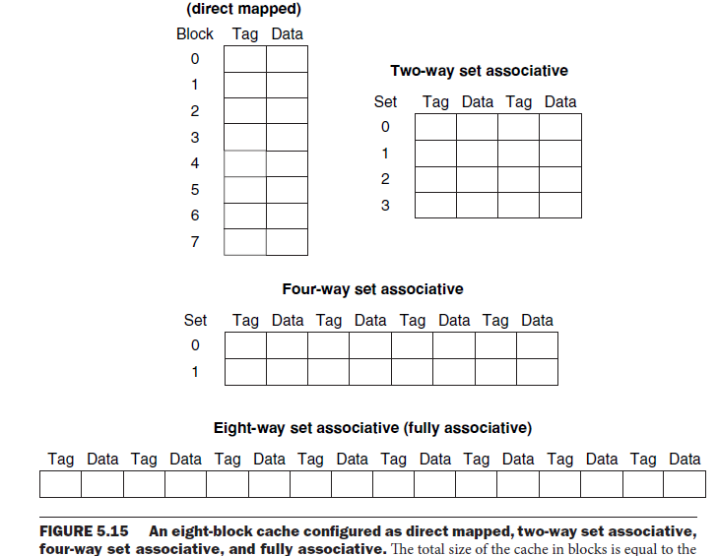

Slide 25
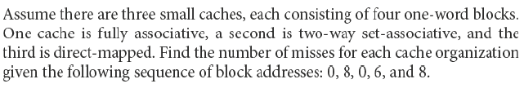
Example: Comparing three mapping schemes

Slide 26
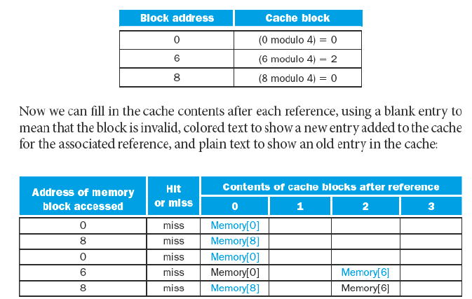
Solution: Direct Mapped

Slide 27
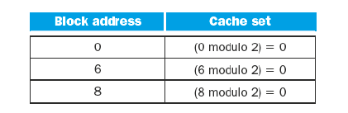
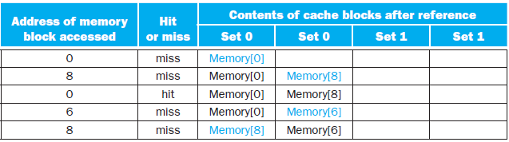
Solution: 2-way set associative

Slide 28
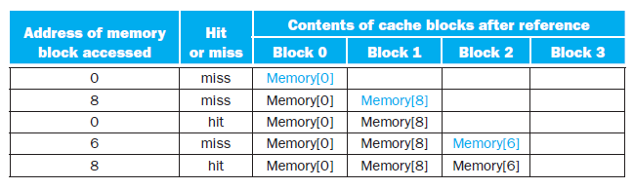
Fully Associative

Slide 29
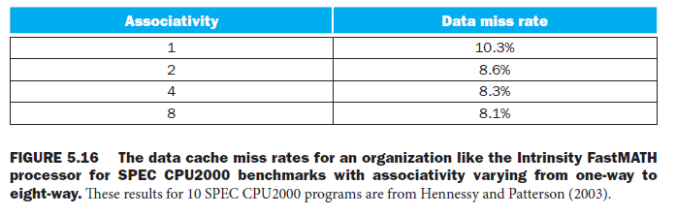
Associativity vs Miss rate

Slide 30
Handling Writes Write Through
There are two types of write mechanisms
Write Through
On a write the main memory is also updated. So data can be discarded when required without lost of information
Easier to implement but performance is reduced if there are frequent writes although in real applications writes are much less then reads
Processor has to wait for each write before executing next instruction so it is like a no cache situation i.e all misses.
Write Buffer is used to hold data until it is written to main memory while it is written to main memory

Slide 31
Handling Writes Write Back
Write Back
Only written to cache and written to lower level only when modified block is replaced.
A dirty bit is added for each block to tell whether it is modified and also control circuitry to check whether bit is set or not.
Replacing a block takes twice the time in case if the block to be replaced is dirty. Because first dirty block is written to main memory and then new block is written to cache.
A Victim Buffer is used to hold the dirty block which is replaced and is to be written in the main memory so that the read operation should not wait`.

Slide 32
Handling Write Miss
There are two ways to handle write misses
Write Allocate
If the memory address which is written is not found in cache then it is brought to cache from lower level and then modified.
Helpful if there is spatial locality
Mostly Used in Write-Back Caches
No Write Allocate:
Not brought and directly written to main memory.
Used in write-through cache

Slide 33
Miss Categories
Three Cs
Compulsory: First access to a block
Capacity: If all required blocks for an operation can’t fit in cache. e.g matrix computation
Conflict: When block replacement strategy is not fully associative in that case multiple blocks may map to same location although there is still room in cache

